Slide 1
K-Nearest Neighbors (KNN) Classification

Slide 2
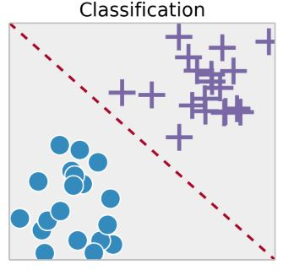
KNN assumes that similar things exist in close proximity.
In other words, similar things are near to each other: some notion of Distance among feature vectors
Sugar Levels
BP

Slide 3
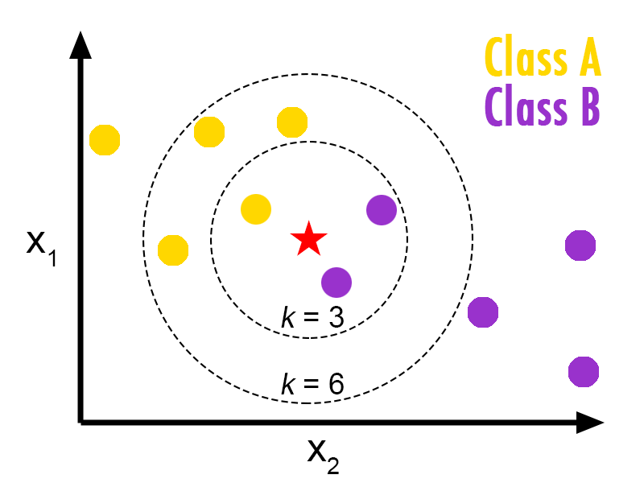
K_Nearest Neighbour Algorithm
To determine the class of a new example E:
Calculate the distance between E and all examples in the training set
Select K-nearest examples to E in the training set
Assign E to the most common class among its K-nearest neighbors
E

Slide 4
K_Nearest Neighbours: Classification Example
A Bank Doing a Credit Card Drive:
Question: Given the age, income and no. of cards a person already holds, should they be offered a NEW credit card?
Customer | Age | Income | No. credit cards | Response
Jay | 35 | 35K | 3 | No
Rina | 22 | 50K | 2 | Yes
Hema | 63 | 200K | 1 | No
Tommy | 59 | 170K | 1 | No
Neil | 25 | 40K | 4 | Yes
Dravid | 37 | 50K | 2 | ??

Slide 5


Closeness Between Neighbors
Each example is represented with a set of numerical attributes
Jay:
Age=35
Income=95K
No. of credit cards=3
Rina:
Age=41
Income=215K
No. of credit cards=2
“Closeness” is defined in terms of the Euclidean distance between two examples
The Euclidean distance between X=(x₁, x₂, x₃,…x_{n}) and Y =(y₁,y₂, y₃,…y_{n}) is defined as:
Distance (Jay,Rina) = $\sqrt{{\text{(}\text{35−41)}}^{2}\text{+}{\text{(95}\text{,000}\text{−215}\text{,000}\text{)}}^{2}\text{+}{(3−2)}^{2}}$

Slide 6
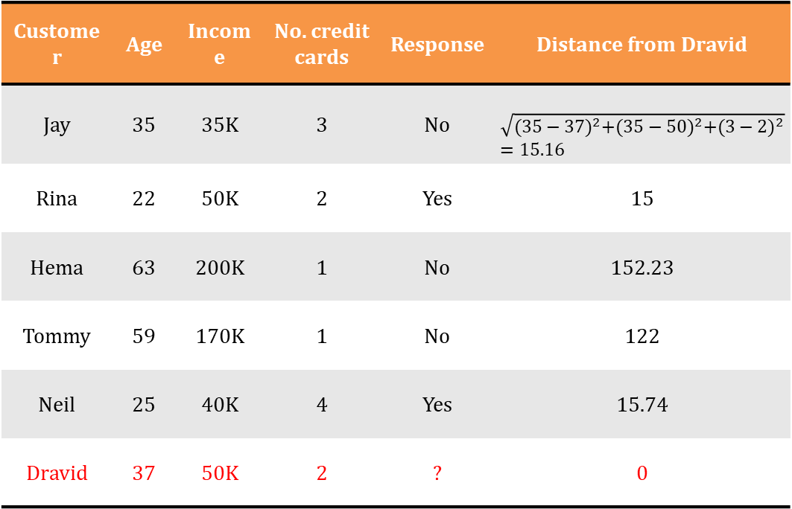
K_Nearest Neighbours: Example
Customer | Age | Income | No. credit cards | Response | Distance from Dravid
Jay | 35 | 35K | 3 | No | $$\sqrt{{(35−37)}^{2}+{(35−50)}^{2}+{(3−2)}^{2}}=15.16$$
Rina | 22 | 50K | 2 | Yes | 15
Hema | 63 | 200K | 1 | No | 152.23
Tommy | 59 | 170K | 1 | No | 122
Neil | 25 | 40K | 4 | Yes | 15.74
Dravid | 37 | 50K | 2 | ? | 0

Slide 7
K_Nearest Neighbours: feature normalization
Jay:
Age=35
Income=95K
No. of credit cards=3
Rina:
Age=41
Income=215K
No. of credit cards=2
Distance (Jay, Rina)=sqrt [(35-45)²+(95,000-215,000)² +(3-2)²]
Distance between neighbors could be dominated by some attributes with relatively large numbers (e.g., income in our example)
Important to normalize some features (e.g., map numbers to numbers between 0-1)
Example: Income
Highest income = 200K
Dravid’s income is normalized to 50/200, Rina income is normalized to 50/200, etc.)

Slide 8
K_Nearest Neighbours: prediction depends on value of k
Normalization of Variables
Customer | Age | Income | No. credit cards | Response | Distance
Jay | 55/63= 0.175 | 35/200= 0.175 | 3/4= 0.75 | No | 0.481 **
Rina | 22/63= 0.34 | 50/200= 0.25 | 2/4= 0.5 | Yes | 0.24 **
Hema | 63/63= 1 | 200/200= 1 | 1/4= 0.25 | No | 0.895
Tommy | 59/63= 0.93 | 170/200= 0.175 | 1/4= 0.25 | No | 0.436 **
Neil | 25/63= 0.39 | 40/200= 0.2 | 4/4= 1 | Yes | 0.537
Dravid | 37/63= 0. 58 | 50/200= 0.25 | 2/4= 0.5 | Yes (k=1) No (k=3)

Slide 9
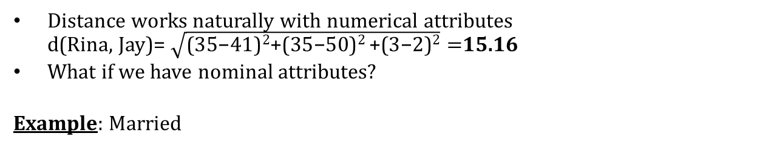
K-Nearest Neighbor: non-numeric features
Distance works naturally with numerical attributes d(Rina, Jay)= $\sqrt{\text{(35−}\text{41}\text{)}\text{2}\text{+(35−50)}\text{2 }\text{+(3−2)}\text{2}}=$15.16
What if we have nominal attributes?
Example: Married
Customer | Married | Income | No. credit cards | Response
Jay | Yes | 35K | 3 | No
Rina | No | 50K | 2 | Yes
Hema | No | 200K | 1 | No
Tommy | Yes | 170K | 1 | No
Neil | No | 40K | 4 | Yes
Dravid | Yes | 50K | 2 | Yes

Slide 10
Dealing with Non-Neumeric Data
Boolean values => convert to 0 or 1
Applies to yes-no/presence-absence attributes
Non-binary characterizations
Use natural progression when applicable; e.g., educational attainment: GS, HS, College, MS, PHD => 1,2,3,4,5
Assign arbitrary numbers but be careful about distances; e.g., color: red, yellow, blue => 1,2,3

Slide 11
k-NN Variations
Value of k
Larger k increases confidence in prediction
Note that if k is too large, decision may be skewed
Weighted evaluation of nearest neighbors
Plain majority may unfairly skew decision
Revise algorithm so that closer neighbors have greater “vote weight”

Slide 12
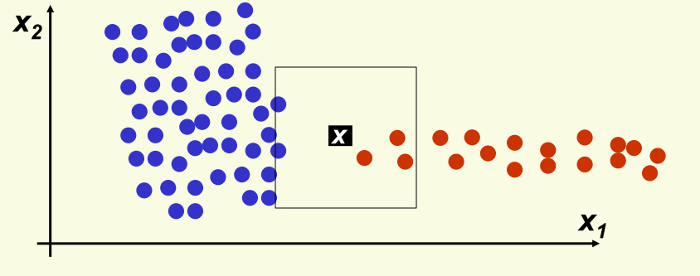
How to Choose ”K”?
For k = 1, …,5 point x gets classified correctly
red class
For larger k classification of x is wrong
blue class

Slide 13
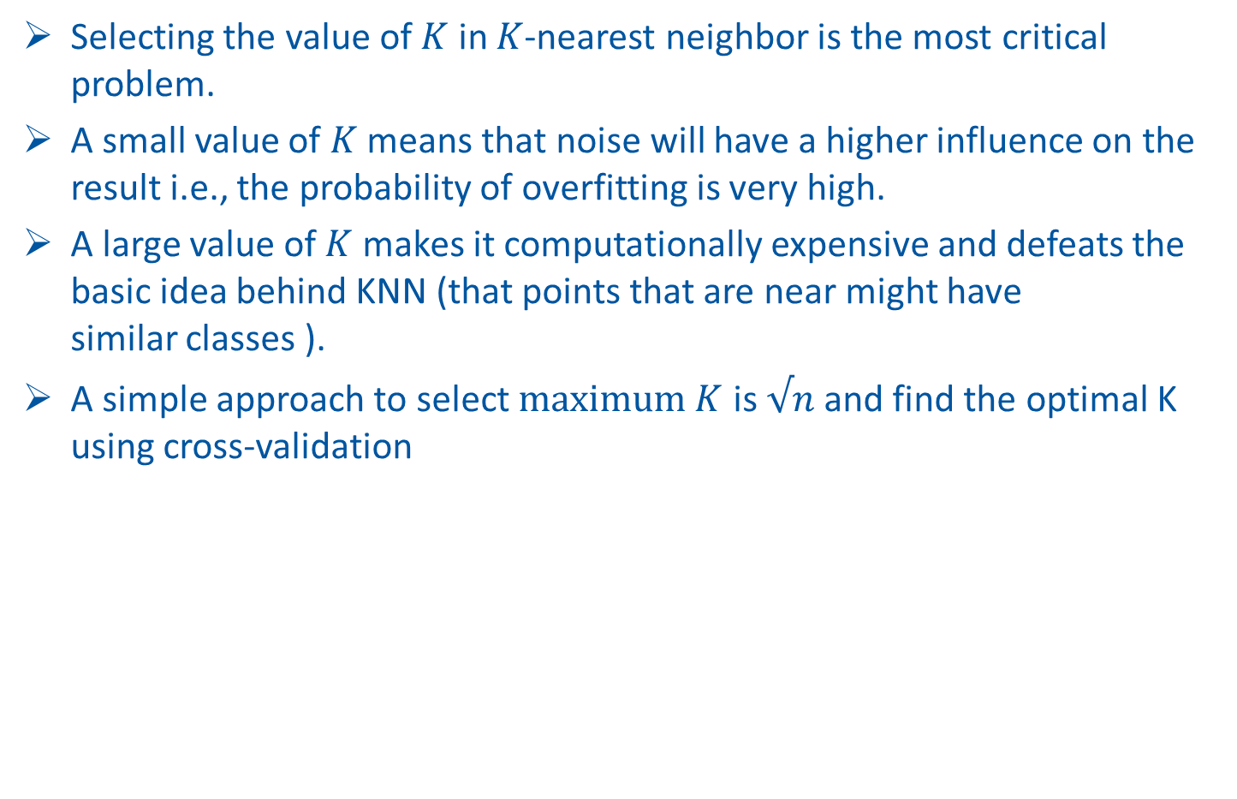
How to Choose ”K”?
Selecting the value of $K$ in $K$-nearest neighbor is the most critical problem.
A small value of $K$ means that noise will have a higher influence on the result i.e., the probability of overfitting is very high.
A large value of $K$ makes it computationally expensive and defeats the basic idea behind KNN (that points that are near might have similar classes ).
A simple approach to select $maximum K$ is $√n$ and find the optimal K using cross-validation

Slide 14
Advantages and Disadvantages
Advantages
Makes no assumptions about distributions of classes in feature space
Don’t need any prior knowledge about the structure of data in the training set
No retraining is required if the new training pattern is added to the existing training set
Can work for multi-classes simultaneously
Easy to implement and understand
Disadvantages
Fixing the optimal value of K is a challenge
Does not output any models. Calculates distances for every new point ( lazy learner)
For every test data, the distance should be computed between test data and all the training data. Thus a lot of time may be needed for the testing

